Slide 1
AI assignment - 2
SEARCH & OPTIMIZATION
Atreya M - CS22B009
Bhukya Lachiram Nayak - CS22B012

Slide 2
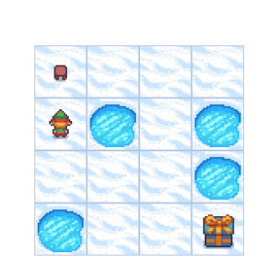
Frozen Lake - Environment
In Frozen Lake
Each cell is a state.
Actions = {Up, Down, Left, Right}.
Transitions are deterministic (non-slippery).
Goal is to find the shortest path to the goal.

Slide 3
1.BRANCH & BOUND
Branch and Bound is a best-first search algorithm that systematically explores paths by expanding the most promising nodes first—those with the lowest estimated total cost (cost_so_far + heuristic).
How it Works
Start from initial state (S).
Maintain a priority queue (min-heap) of paths, prioritized by their cost + heuristic.
At each step:
Pop the path with the lowest priority.
If it reaches the goal (G), return it.
Otherwise, expand the path by moving in all possible directions (up/down/left/right).
Add each new path to the queue if the resulting state hasn't been visited.
Repeat until goal is found or queue is empty
cost_so_far: Number of steps taken.
heuristic: Estimated cost to goal (we use Manhattan distance).

Slide 4
Advantages
Explores only the best candidate paths first.
Finds optimal solution if heuristic is admissible .
Disadvantages
May explore many unnecessary paths if heuristic is weak.
Memory intensive (stores many partial paths).

Slide 5
BnB

Slide 6
Iterative Deepening A*
IDA* combines depth-first search (DFS) with the cost-based pruning of A*. It performs a series of depth-limited searches, increasing the cost bound at each iteration.
HOW IT WORKS:
Set an initial cost bound using: bound = heuristic(start)
Run a DFS, only exploring paths where: cost_so_far + heuristic ≤ bound
If the goal is found, return it
If not found, increase the bound to the minimum value that exceeded the last one and repeat.
Process
Each iteration is a DFS up to a given cost threshold.
The threshold is incrementally increased (hence "iterative deepening").

Slide 7
Advantages
Memory efficient (like DFS).
Optimal solution .
Works well in large state spaces.
Disadvantages
Slower than A* due to repeated work.
Requires careful tuning to avoid recomputation overhead.

Slide 8
IDA*

Slide 9
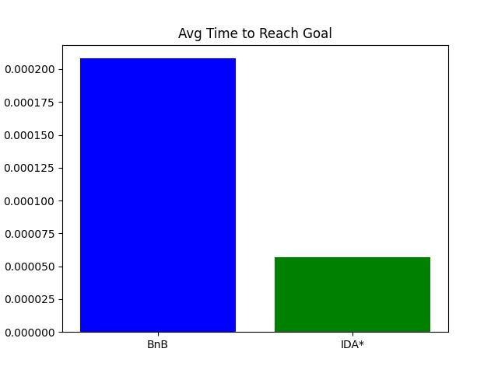

Slide 10
What’s the key difference with BnB and IDA*?
BnB tries to explore all possibilities but skips branches that are worse than the best solution found so far.
IDA* combines the benefits of A* (heuristics) with iterative deepening to explore efficiently.
Even with pruning, BnB often has to explore a large part of the search space, especially early on. If a better solution is found late, earlier pruning isn’t very effective.

Slide 11
Traveling Salesman Problem - Environment
Experiment Setup
Environment: 20 random 2D points (mk_env).
Objective: Minimize total path length (TSP).
Evaluation:
Each algorithm runs 5 times.
Average cost is calculated and visualized.
Final tour is saved as a plot (hc_tour.png, sa_tour.png).
Generating the cities using np.random.rand() , and we can compute distances between cities using numpy op

Slide 12
3.HILL CLIMBING
Hill Climbing is a greedy local search algorithm. It continuously moves towards a better solution by exploring its neighbors, hoping to reach the optimal solution.
How It Works
Start with a random tour (a random permutation of points).
Repeatedly:
Pick two indices i < j.
Reverse the segment between i and j (a 2-opt move).
If the new tour has a lower cost, accept it.
Else, revert the change.
Run this for a fixed time (t seconds in the code).
Cost Function: The total distance of the tour

Slide 13
AAAdvantages of Hill Climbing
Simple to implement
Fast and efficient
Uses little memory
Disadvantages of Hill Climbing
Can get stuck in local optima
No backtracking
Not good for complex landscapes

Slide 14
Simulated Annealing
Simulated Annealing is an advanced local search algorithm inspired by the annealing process in metallurgy. Unlike hill climbing, SA accepts worse solutions with a certain probability to escape local minima.
How It Works
Start with a random solution .
Initialize temperature T
Repeat until time expires or T is very small:
Choose two points i < j and reverse the segment (2-opt move).
Compute cost difference d = new_cost - old_cost.
Accept the move if:
d < 0 (better solution), or
exp(-d/T) > random() (probabilistic acceptance).
Gradually decrease temperature: T *= cool_rate (like 0.995).
Temperature Schedule
Starts high to allow exploration (accepting worse paths).
Gets stricter over time (low temperature = greedy).

Slide 15
Advantages
Escapes local minima.
Can find global optima over time.
Disadvantages
Slower than hill climbing.
Requires careful tuning (initial temperature, cooling rate).

Slide 16
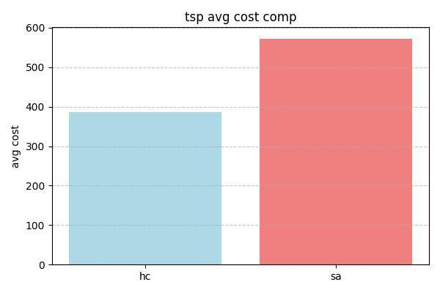

Slide 17
